Slide 1
Revature Project 1: Web-API
(Model & Controller)
by
Cody Scholberg

Slide 2
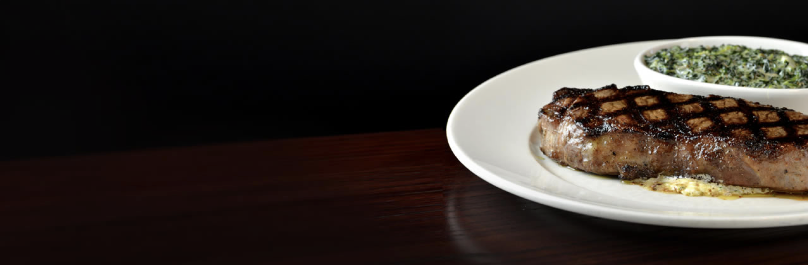
introduction
I got a job the second week of Revature as a server at THE CHOP HOUSE, and, because I need to learn their menu thoroughly, I decided to "do two things at once" by making a restaurant API to order their menu items.

Slide 3
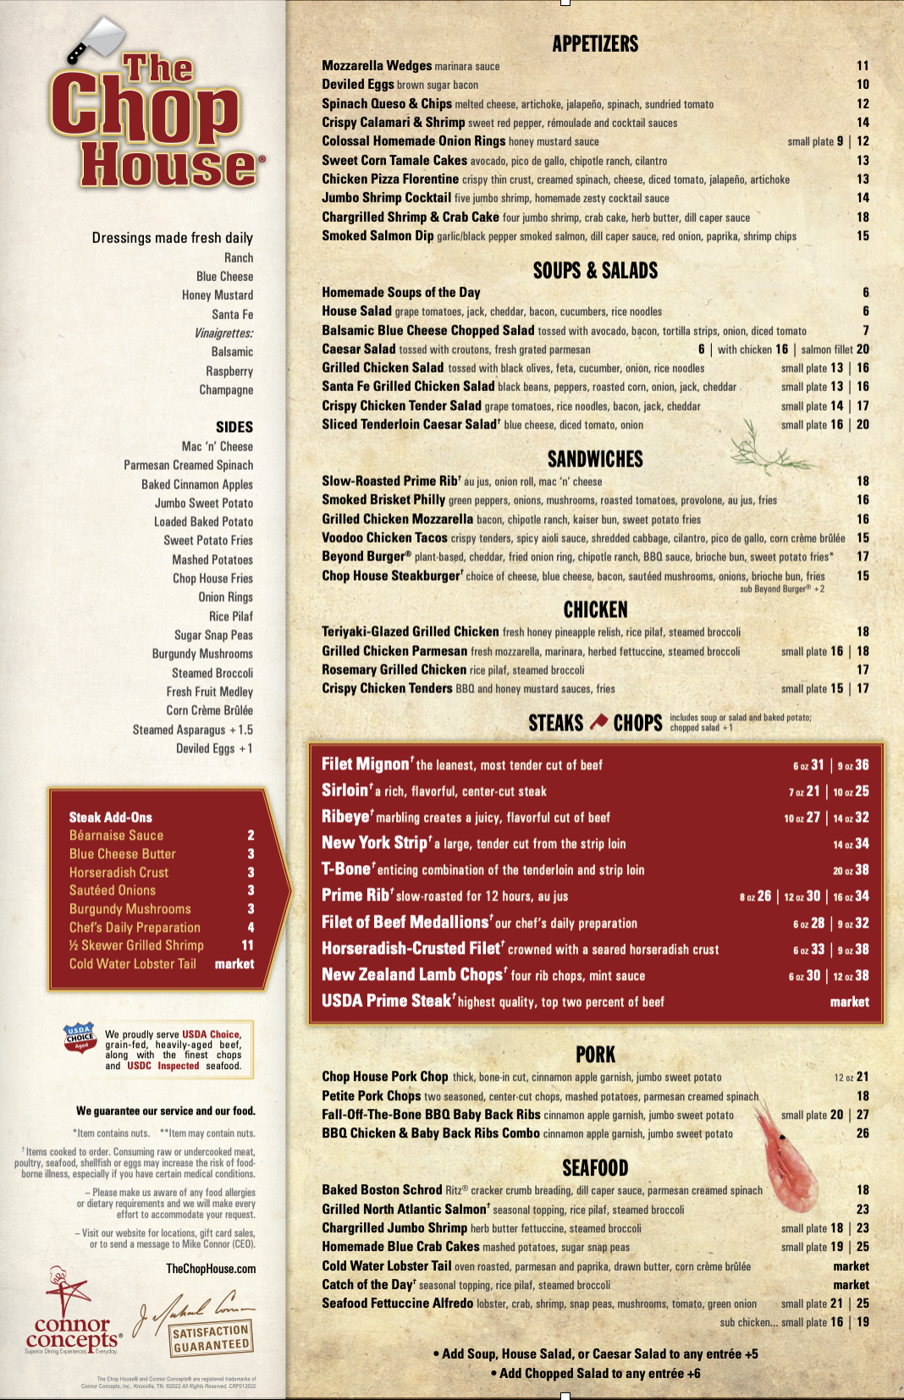
The Menu

Slide 4
tech
-Visual Studio for Mac
- C#
- .NET Core 5.0
-ADO.NET
-Swagger
-Serilog
-SQL Server
-Azure Data Studio
-Docker (for SQL Server)

Slide 5
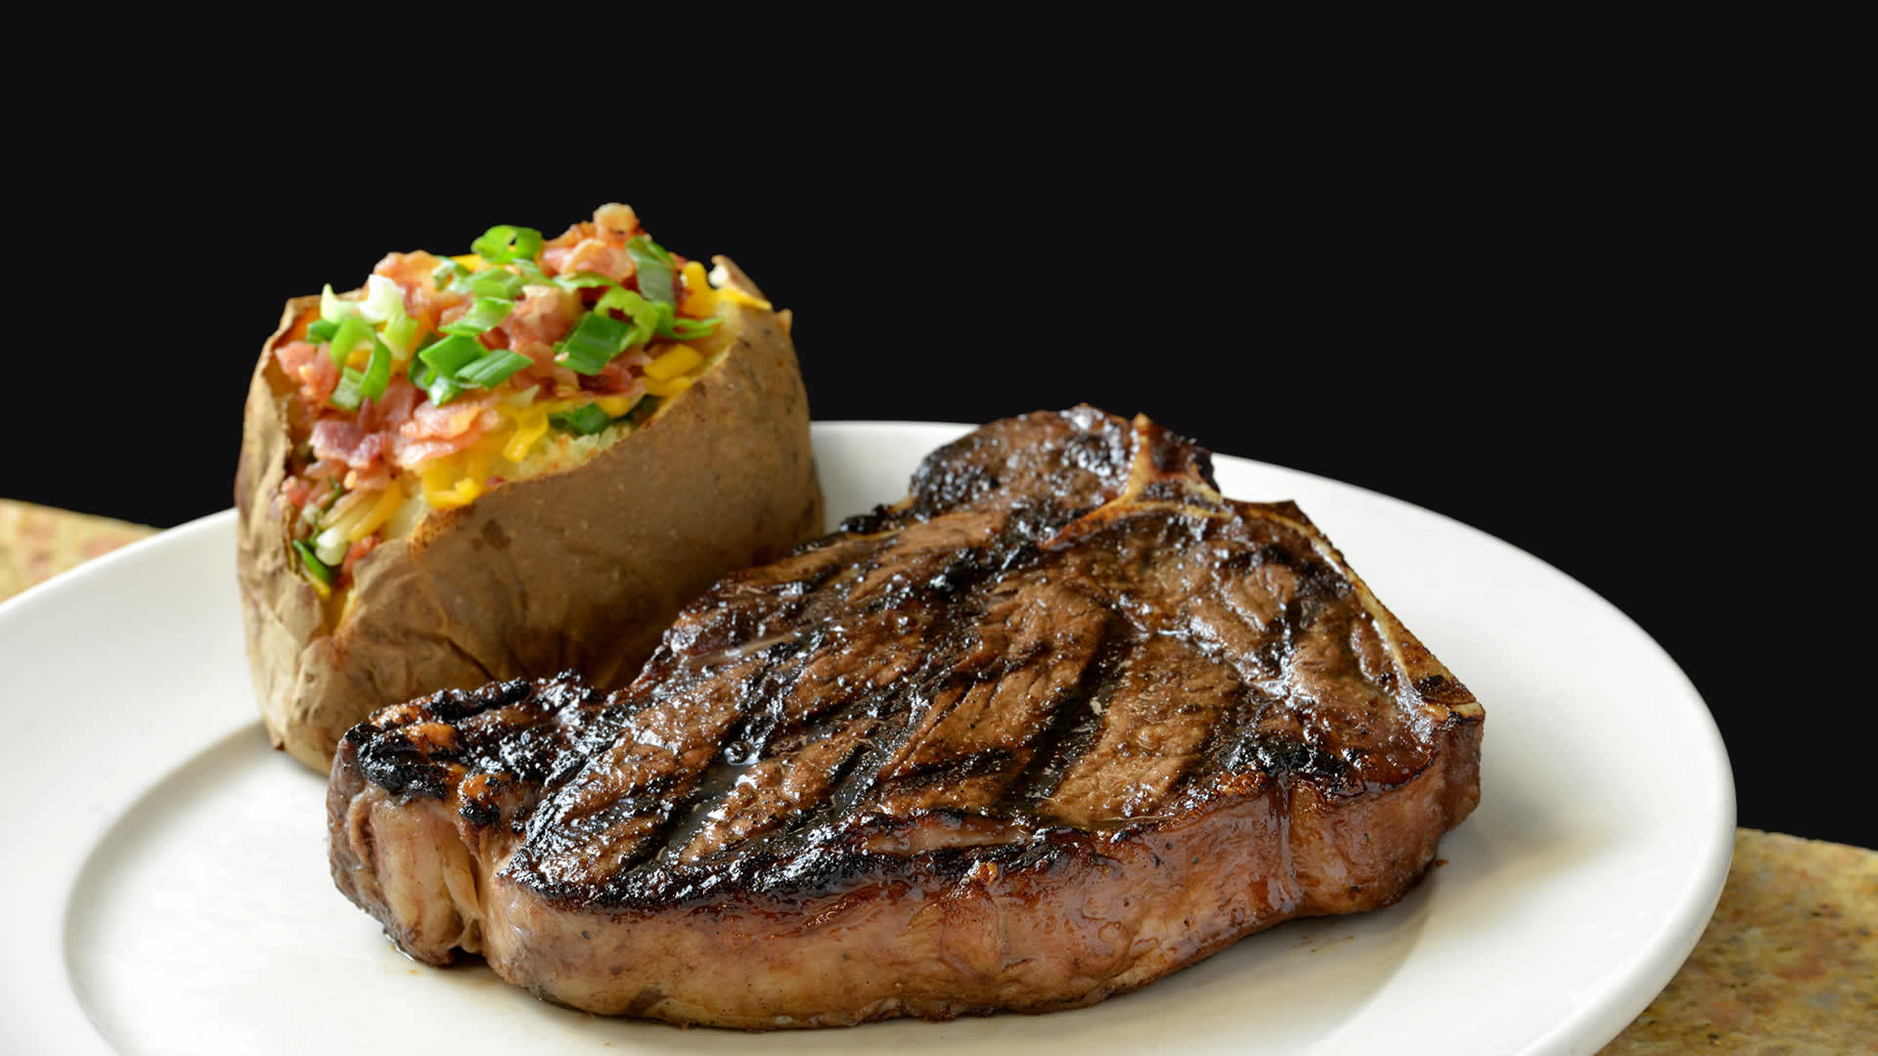
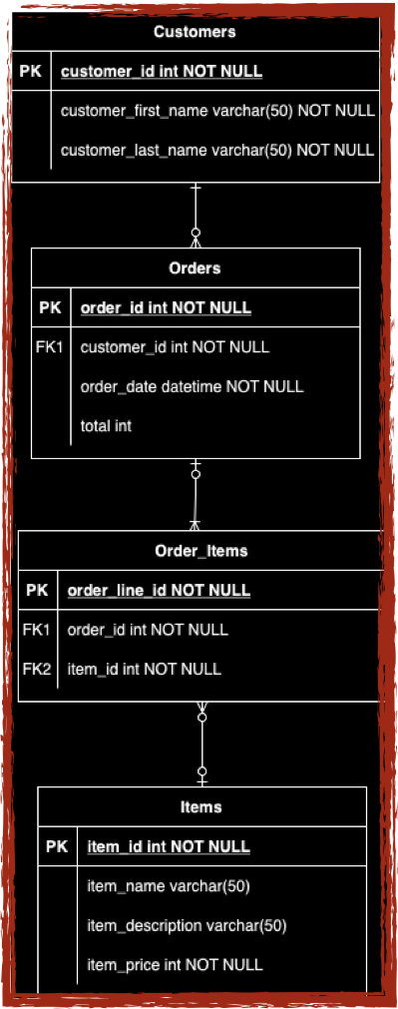
entity relationship diagram
This database is schema is in third normal form.
i had to create an order_items table in between the orders and items tables to handle the many-to-many relationship that orders and items have

Slide 6
And Now,
The demonstration

